Slide 1
Migration and translocality: The Albanians from Macedonia between receiving Swiss society and local community of origin
Conference on international migration
14th February 2014, Economic Research Institute– BAS
Ivaylo Markov, PhD, Assist. Professor
Institute of Ethnology and Folklore Studies
with Ethnographical Museum
Bulgarian Academy of Sciences, Sofia, Bulgaria

Slide 2
Introduction
The aim of the paper is to examine the migrations of Albanians from Macedonia to Switzerland.
The main thesis is that Albanian migrants in Switzerland still remain highly interconnected through stable networks characterized by high ethnic homogeneity; simultaneously, they are strongly associated with their places of origin in Macedonia. Reasons for this are various and go beyond family and kin solidarity.

Slide 3
Theoretical notes
I employ the social networks theory in order to grasp the relations between migrants, returnees and non-migrants, all of whom are engaged in a set of complex social and interpersonal relations through kinship, friendship, and feelings of affection towards the shared place of origin (Massey et al. 1993: 448). These networks – of information, assistance and obligations – allow us to understand why migratory movements are not necessarily limited in time, unidirectional or permanent (Boyd 1989: 641).
Transnational paradigm: transnationalism is the process by which migrants forge and sustain multi-stranded social relations that link together their societies of origin and settlement’ (Glick Schiller, Basch and Szanton Blanc 1995: 48). Transmigrants differ from emigrants and immigrants, and from returnees, because they move back and forth between different places interacting within ‘transnational social fields’.
According to Janine Dahinden (2010) I assume that transnational formations are result from a combination of transnational mobility/migration, on the one hand, and locality in the sending or/and receiving country, on the other. Locality means being rooted or anchored – socially, economically or politically – in the country of immigration and/or in the sending country; it means developing/having a set of social relations at specific places.

Slide 4
Sources and Methodology
Census data: State statistical office of R. Macedonia, Emigration Agency of R. Macedonia, Swiss Federal Statistical Office.
Ethnographical fieldwork is the main source in my study. Five field research sessions of 10–15 days each were carried out between 2008-2010 in the western areas of Macedonia, where the Albanian population is concentrated. Namely this were in regions of Skopje, Tetovo and Struga.
Most of the interviews I conducted were a combination of semi-structured and biographical (life history) narratives. The life-history approach is very valuable in studying processes, social changes and everyday life, especially in cases when the archives are incomplete or missing (Thompson 1978).
Life histories allow us to observe the changes in the cultural and social experience of the individuals, their points of view and daily cultural practices, and in the meanings people invest in their actions (Roberts 2002: 21). This approach takes into consideration the fact that life histories are subjective, but finds them valuable as they reveal the respondents’ opinions, dispositions and attitudes (Lieblick, Tuval-Maschiach and Zilber 1998).

Slide 5
The migrations of Albanians from Macedonia to Switzerland: historical dynamics and characteristics
The end of 1960s is the start of mass migrations of Albanians from Macedonia to Switzerland. This movement were part of Yugoslavian migration policies at that time.
During the first decade Switzerland was less preferable destination than Germany and AustrIa.
Until the mid 1980s, Albanian migrants were exclusively young men, while their women and families stayed in the native villages. They came from rural and poor regions, worked mainly in unskilled jobs and often lived in barracks with other foreign workers. Their objective was to earn money in order to financially provide for their families in Macedonia and to return after a few years to native village.
Initially, Albanian migrants entering legally Switzerland received a seasonal permit. It has a maximum duration of 9 months per year The holder was not allowed to bring family members to Switzerland. Workers with uninterrupted seasonal permits for 10 years can obtain one-year permits (permit B). This permit allowed the family reunion under certain conditions – the worker had to prove that he had the financial possibility to secure himself and his family. After 10 years, the permit can be converted into an establishment permit (Permit C) valid indefinitely with no constraint on mobility.

Slide 6
The migrations of Albanians from Macedonia to Switzerland: historical dynamics and characteristics
In the end of 1970s and in the beginning of 1980s for many Albanians coming from Macedonia the Switzerland became more preferable destination than Germany or Austria. At that time the 10-year period of those arrived first expired and they could get the annual residence permit. Simultaneously the waiting period for conversion was reduced to five years. Thus gradually a process of family reunion took place, made possible by the transformation of the residence status. After mid 1980s more and more Albanian men started bringing their women and children in Switzerland:
“I went to Switzerland in 1980. The wages in Macedonia were very low. And I left with a friend of mine who had already worked there for 2 years. My family remained in Macedonia. I was allowed to work for 9 months – from the 15 of March to the 15 of December. And for 3 months I came back home. In this way we lived separated 6 years. However then we obtained the rights to bring our families. I got in 1985 the permit which allowed me to stay round year in Switzerland and to bring my family. I brought them in 1986.”
During 1960s-1970s the public perception almost completely ignored immigration as the migrants were predominately single men and thus not visible in the public space or in schools. Furthermore they were residing in the outskirts on construction sites and in barracks. Afterwards with the change of migration structure and character from single males to family migration, they moved from the outskirts to inner city areas (von Aarburg 2002: 271) and became more visible provoking the public attention. These tendencies continued and intensify during the 1990s.

Slide 7
The migrations of Albanians from Macedonia to Switzerland: historical dynamics and characteristics
From the mid 1980s on, the political and economic situation in former Yugoslavia in general, and specifically in the populated with numerous Albanians Kosovo and Macedonia, worsened drastically. After Tito’s death in 1980 and Slobodan Milosevic’s political rise the Albanian population began to lose gradually the given previous rights.
Situation did not improve after the disintegration of Yugoslavia in 1991and formation of the independent Macedonia. The 1990s was a period of deep political, economic and social change and accumulation of still more ethnic tensions which led to the armed conflict in 2001.
In this complicated situation the desires for migration abroad grew. However, with a shift in immigration policies in Switzerland, and especially with the implementation of the ‘three-circles’ model in 1991, the recruitment of workers from countries succeeded former Yugoslavia was no longer possible: Albanian migrant from Macedonia were now categorized as members of the third circle and had no rights to obtain a work permit (Swiss Federal Council 1991).

Slide 8
The migrations of Albanians from Macedonia to Switzerland: historical dynamics and characteristics
The established culture of migration played a crucial role during the 1990s and 2000s so that the migrations continued with high intensity, despite the restrictions. The strong endogamous tradition among Albanians is an important factor as marriage became a way of overcoming these restrictions. Hence, the main source of the new Albanian migration from Macedonia during these post-socialist decades has been the family reunion and family formation.
At the same time, politically motivated migration started. There was the arrival of thousands of Albanian refugees and asylum seekers. In fact, the asylum seeking became an important strategy for many Albanians to circumvented the policy of ‘three-circles’ and to migrate in Switzerland. Many of them had family ties in Switzerland from labour migration previous periods. Claimants for refugee status were able to work under some conditions regulated by the canton (Gross 2006: 32). Some of my respondents also spoke of this:
“I went to Switzerland in 1992. I was there registered as an asylum seeker and I worked as porter and façade maker. I left because of poverty. Then here in Macedonia there wasn’t work for the young people. And I decided to leave. I have many relatives there. I have an uncle who has lived in Switzerland since1968. My oldest brother – since 1984, and the other one – since 1991”.

Slide 9
Numbers
Macedonian citizens in Switzerland
Employed in Switzerland |  |  | Members of families |  | Total
1971 | 1981 | 1994 | 1981 | 1994 | 1981 | 1994
857 | 5.476 | 12.193 | 809 | 11.582 | 6.285 | 23.775
 | 87 % | 51 % | 13 % | 49 % | 100 % | 100%
* Data summarized by V. Janeska (2001: 214)

Slide 10
Numbers
* Data of Swiss Federal Statistical Office

Slide 13
Migration networks, transnational practices and locality
During the last three decades migrations of single men leaving their women and children at place of origin existed parallel to the migrations of entire families.
Different types of migrants (also in the sense of gender and age) living or only temporary working in Switzerland, has been found to be interconnected economically and emotionally through kinship and friendship, as well as they have been strongly linked to relatives and local communities Macedonia.
This reality has been reflected by way of an important economic and financial support, but also through political mobilization (Iseni 2013: 230-231).

Slide 14
Migration networks, transnational practices and locality
Data suggest that on the level of everyday life and daily interaction, Albanian migrants developed a strong local orientation. The most Albanian migrants are concentrated in definite cantons and towns in Switzerland (mainly in German speaking parts of the country). The networks display a strong ethnic homogeneity.
Although the respondents say that they have Swiss or Italian friends, later in the course of the interview it makes clear that such interaction are only within the workplace. Swiss people are important exclusively for the dimension of instrumental support
Speaking of general advice about professional or family affairs, economical and emotional support they rely on other Albanians (relatives or friends).
In the early stages of migration (until mid 1980s) seasonal (male) migrants lived on the margins of the host country, but leading a parallel social life to mainstream populations of Switzerland. In order to save money, they restrain their consumption to a minimum. Their point of reference was the places of origin where their families lived and relied on their economic support.
Financial remittances continued to be sent throughout the 1990s and well into the 2000s. The Albanian migrants have been and continue to be a crucial force in the socio-economic well-being of their origin areas in Macedonia.

Slide 15
Migration networks, transnational practices and locality
Remittances
Precise data about the means that Albanian migrants use to remit to their relatives, however, are lacking. The channels of sending money in most cases are informal, the key ones being self-delivery and via friends and relatives. Only 22% of the migrants responding to a recent survey sent money through formal banking channels (Mughal, Cipusheva and Abazi 2009, 64–70).
The official data suggest that during the last 15 years the total remittances sent by Macedonian citizen to Macedonia has been raised, even during the years following the 2008 economical crises.
Remittances in Macedonia (in millions, US)
Year Source | 1998 | 1999 | 2000 | 2001 | 2002 | 2003 | 2004 | 2005 | 2006 | 2007 | 2008 | 2009 | 2010 | 2011 | 2012
World Bank | 63 | 77 | 81 | 73 | 106 | 174 | 213 | 226 | 267 | 345 | 407 | 381 | 388 | 434 | 505
National bank of the Republic of Macedonia | 42,6 | 64,2 | 66,3 | 47,5 | 69,8 | 130,3 | 146,3 | 155,3 | 182 | 216,9 | 238 | 237,9 | 240,6 | 250,7 | 234,7

Slide 16
Migration networks, transnational practices and locality
Remittances
Households receiving remittances from relatives working abroad*
* Source: DoTM Survey (2008); UACS Remittances Survey (2012).

Slide 17
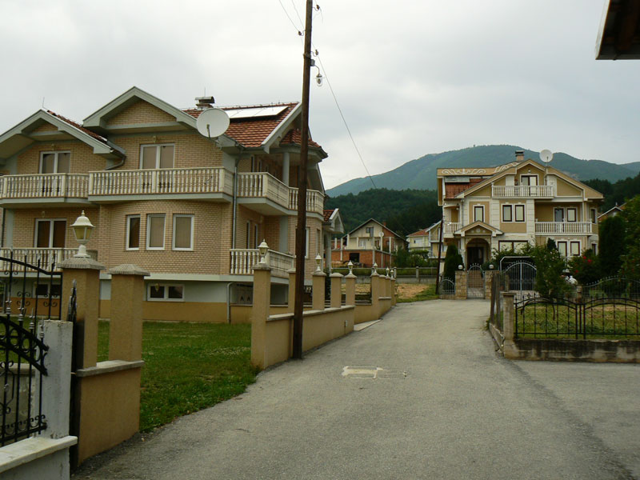
Migration networks, transnational practices and locality
Remittances
Remittances are spent first and foremost to meet essential needs locally – food, medicines, clothing, different taxes and fees.
The most visible are the funds invested in the reconstruction or construction of houses, as well as in their furnishing.

Slide 18
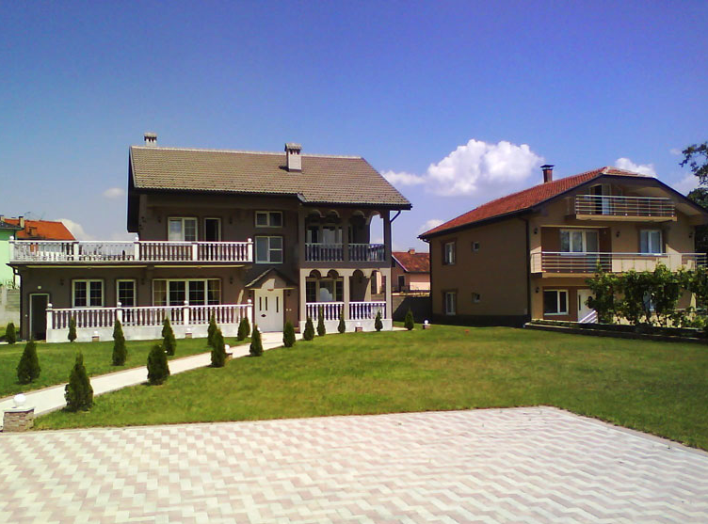
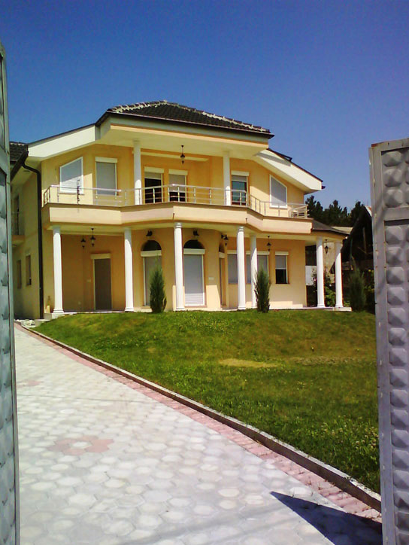
Entering an Albanian village one might be impressed by the number and the size of the houses created by such remittances, with varied planning and architectural features. Most of these houses have been built in the last 20–30 years.

Slide 19
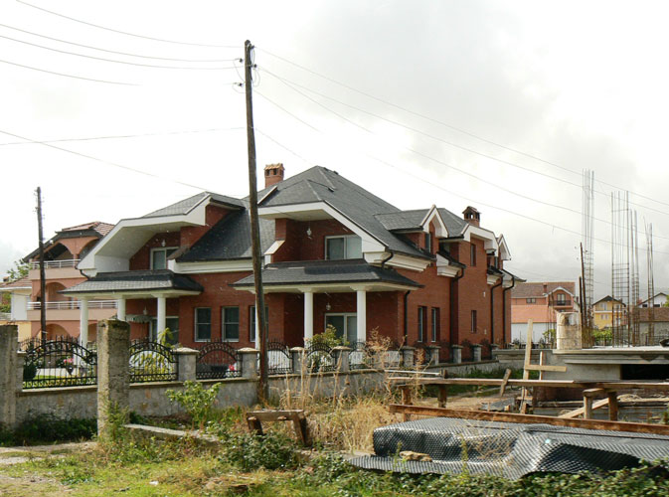
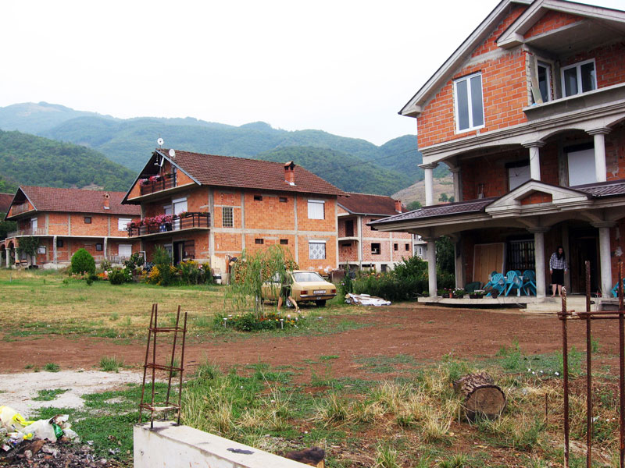
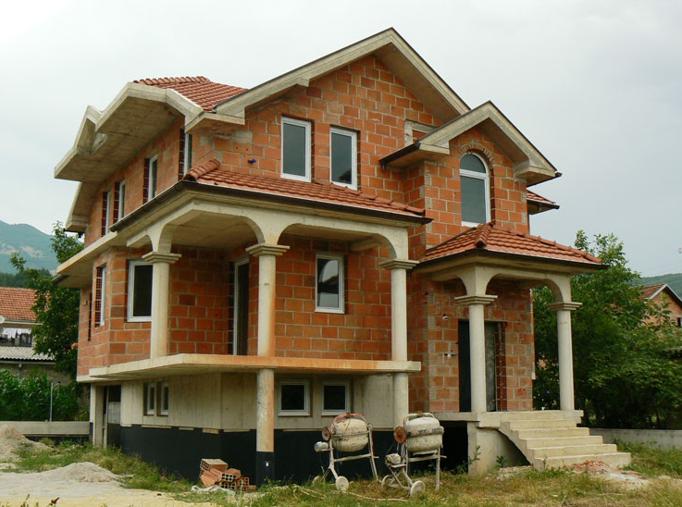
Мany houses are still under construction.

Slide 20
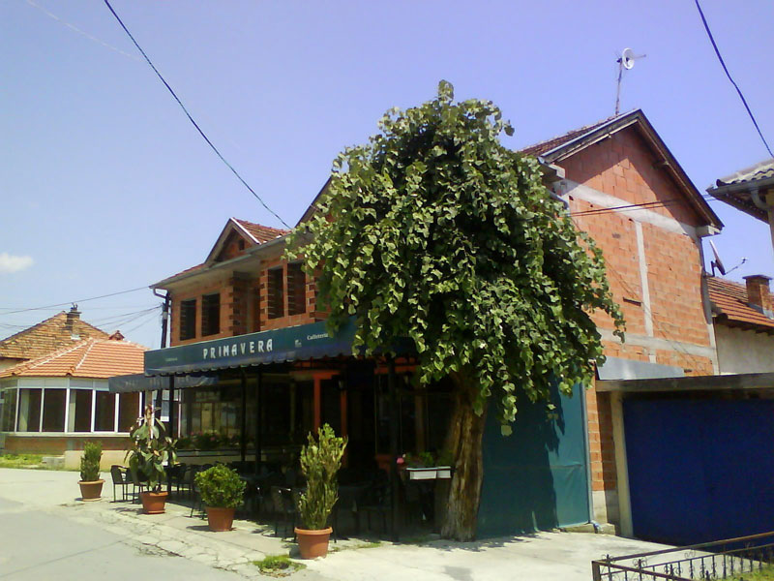
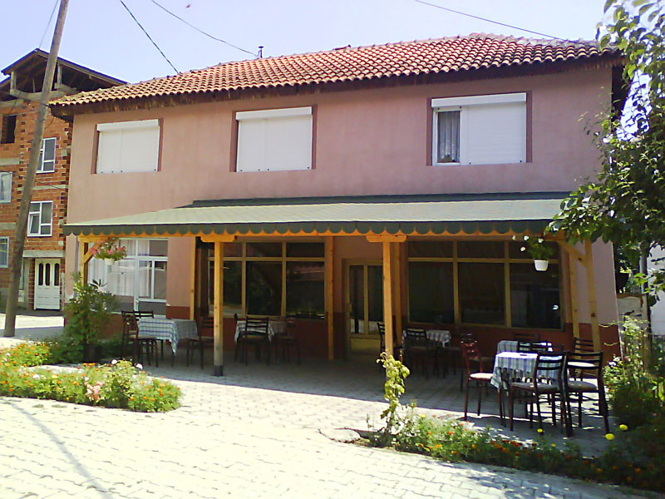
Migration networks, transnational practices and locality
In addition to these expenditures, some remitted funds are invested in production activities. The majority migrants want to invest their savings in small businesses in their native place, aiming to provide a regular income for their families.

Slide 21
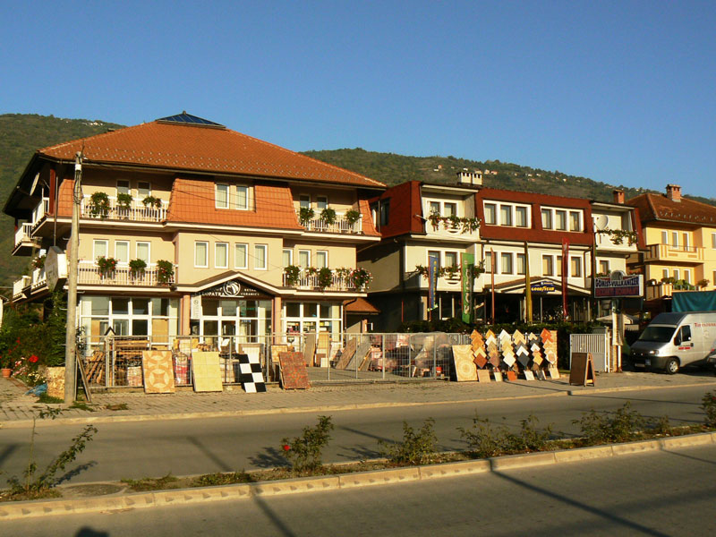
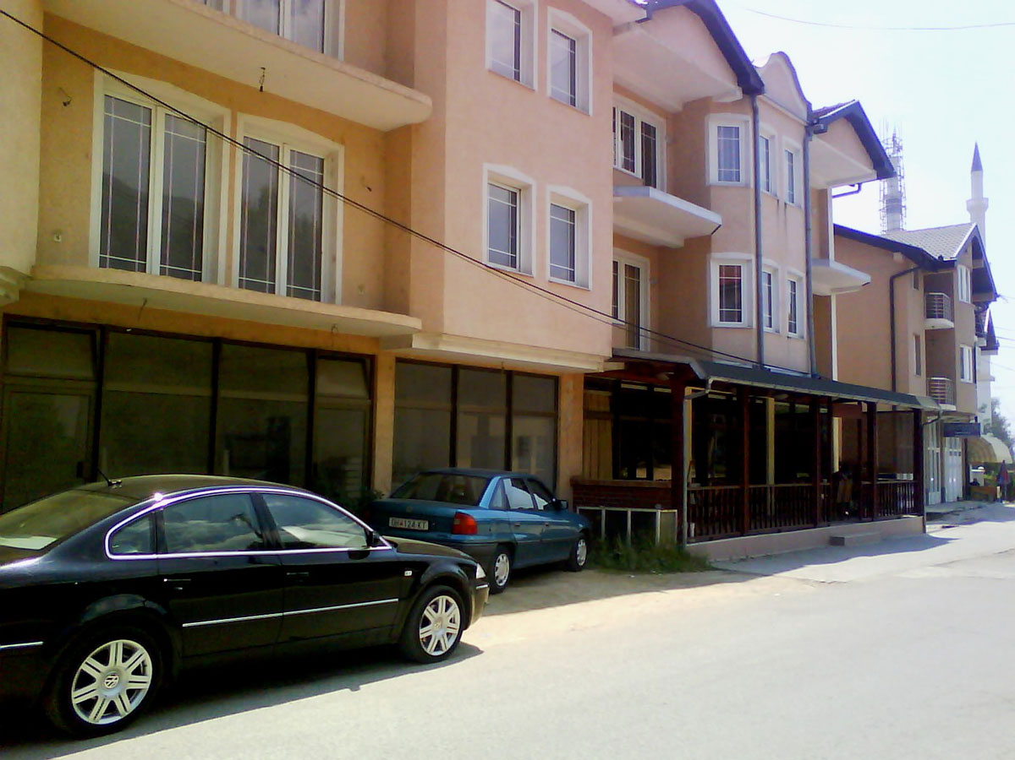
Migration networks, transnational practices and locality
Some of these initiatives are sustainable due to periodical money transfers by the owner’s brothers who continue to work in Switzerland.

Slide 22
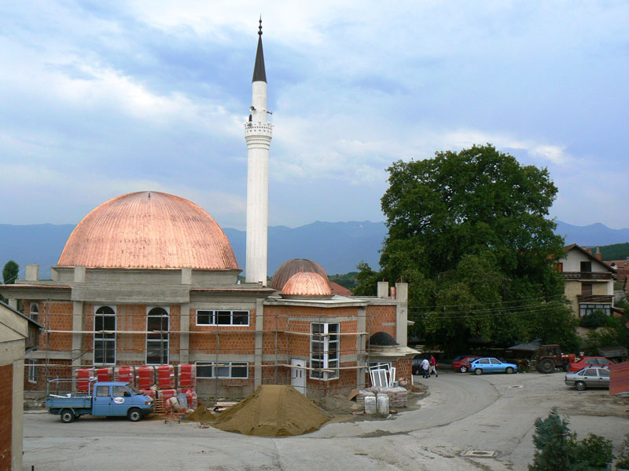
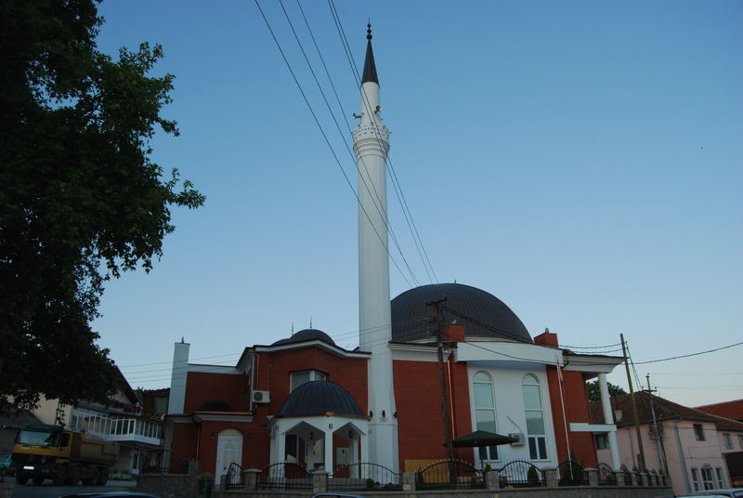
Migration networks, transnational practices and locality
Collective Remittances
Besides individual remittances, the villages of origin are transformed by an injection of collective funds in public infrastructure and services. Respondents in all research villages explained the existence of a special fund to which each village household must pay a certain contribution according to how many members they have working abroad and their income. The money has been invested in asphalting streets, building bridges and fountains, renovating schools and religious sites or supporting vulnerable households such as those seriously ill or hit by some disaster.

Slide 23
Migration networks, transnational practices and locality
Status-paradox
Supporting the welfare of relatives and participating in community life in places of origin the migrants reduce the possibility of falling into a situation of social isolation.
This is tied to a specific status-paradox which emerges: Most migrants are employed in host societies as unskilled workers, often illegally, and thus are unable to gain a high position there. Their social position abroad is relatively low. However they have a chance to become socially prestigious in their origin places sending money, and thereby, to raise their status there.
In general, a migrant’s success depends not so much on their status abroad, but on the remittances sent to origin areas. For that reason the results of migration must be made visible to the community.

Slide 24
Migration networks, transnational practices and locality
Status-paradox
The large houses in Albanian villages are an obvious mark demonstrating well-being and enhanced social prestige. They are, indeed, visible for the local community. My male respondent, have worked in Swirzerland, said:
There is a contest – to build a larger house than others. There are such people, many people. For instance, if he has an old house, he will demolish it and erect a new one. And it should be larger than the neighbour’s house. In order to demonstrate himself he would even build a swimming pool.

Slide 25
Migration networks, transnational practices and locality
Status-paradox
Another visible expression of prestige and an improved social position is the manifestation of well-being to the native village when migrants return during the summer. For several weeks the villages are buzzing with people and expensive cars with foreign registration number plates – from Switzerland, but also from Germany, Austria, USA etc. The cafés, pubs and restaurants are overcrowded during the entire day. Young people show off the latest mobile phone models or walk along the main street of the village wearing designer clothes.

Slide 26
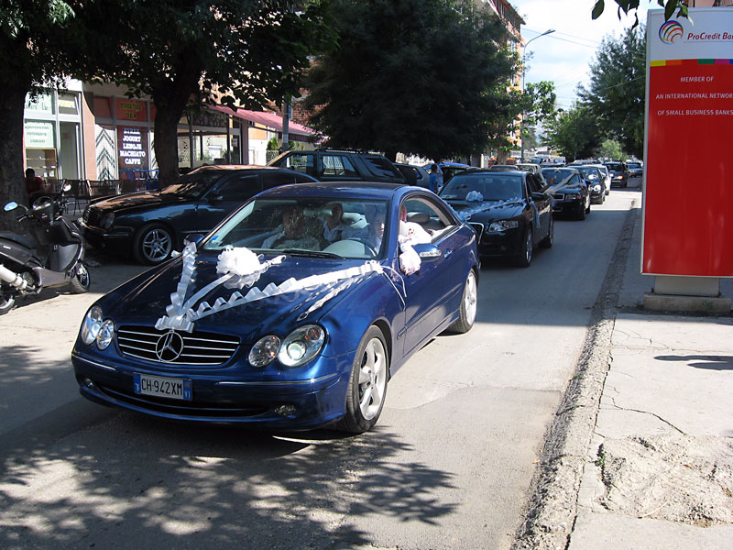
Migration networks, transnational practices and locality
Status-paradox
The grand weddings can be also noted. They are organized between July and August, the period in which most migrants have their annual holidays and return to their origin villages. Every day there are two, three, sometimes more weddings. The bride is often from the same village as the groom.
The wedding is a luxurious and lavish ceremony. Nowadays the number of guests usually reaches a few hundred. A noisy procession with expensive cars, loud Albanian music, blaring horns and Albanian flags passes through the village, so as to stress wellbeing and social position.
Organizing such events is possible and rational only in the place of origin, since only the local people can comment on their customs and only for them can the material and social aspects of weddings be observed and valued.

Slide 27
Migration networks, transnational practices and locality
Ethnic tensions and translocality
Recent researches show that the first generation of immigrants often remains more dependent on relationships with persons of the same ethnic background, while he second generation has fewer reference people of the same ethnicity.
Often children of first generation Albanian migrants have better education and work position than their parents and keep interpersonal relation with people of other ethnicity. However the ethnic mobilization remains very strong even among the second generation.
The continuing with big intensity ethnic and political tensions in Macedonia are another important factors for prolongation of ethnic consolidation and empathy, as well as for maintenance of close ties with the areas of origin.
Thus the support for places of origin has another meaning – the migrants constantly reaffirm that they are still and will continue to be “Albanians”.
The solidarity with the origin community can be seen as a sort of political statement.

Slide 28
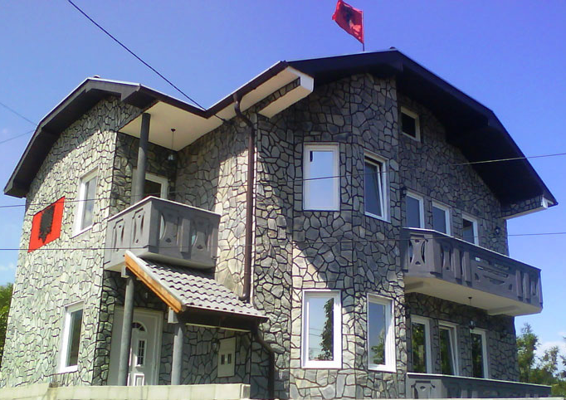
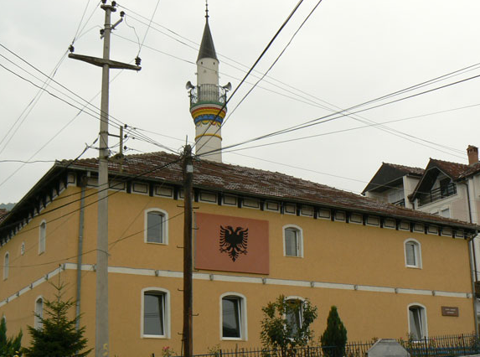
Migration networks, transnational practices and locality
Ethnic tensions and translocality
For the Albanians from Macedonia it is important to state clearly their Albanian identity, regardless they work and live mostly in any Western country or they stay at home village. The demonstration and ostentation of wealth, the use of Albanian national symbols in architecture and rituals are designed to demonstrate strong feelings of Albanian identity and ethnic solidarity.
Thus, the remittances and strong social networks between Albanian migrants and their places of origin have an additional meaning – to be declared new positions and claims for increased role of the Albanian population in the Macedonian state.

Slide 29
Migration networks, transnational practices and locality
Ethnic tensions and translocality
Undoubtedly the ethno-political tensions in Kosovo as well as in Macedonia have influenced the evolution of Albanian immigration in Switzerland.
Among people who received asylum status in the 1990s are many Albanian political activists. This enabled them to establish themselves in these countries and follow their political aims from there.
Under the leadership of political figures, and following the development of events in Kosovo and Macedonia, the majority of the Albanians in Switzerland became highly politicized (Iseni 2013). Their political activities irritated politicians in their areas of origin.

Slide 30
Migration networks, transnational practices and locality
Ethnic tensions and translocality
The active political mobilization among the Albanian diaspora in Switzerland in the 1990s is commented in the public discourse, as well as in some research studies. This was reflected in a number of ways:
An active political and public life was developed
Various Albanian formations was established in order to support political activists in Kosovo and Macedonia.
Albanian diaspora is strongly engaged in political lobbying in Western countries in order to influence public opinion there, through the arrangement of meetings with political leaders from Kosovo and Macedonia.
Different publications in the media, organizing public demonstrations, petitions and various other campaigns were also important (Iseni 2013 : 233 )

Slide 31
Migration networks, transnational practices and locality
Ethnic tensions and translocality
In this context , speaking of collective remittances and funds sent to help their places of origin, my respondents only hinted that some of these funds have been used for political purposes.
A widely discussed (especially in the media) issue is the funding of Albanian paramilitary formations provided by the Albanian emigrant circles in Switzerland in times of the armed conflicts in Kosovo and Macedonia during 1998-2001.
The theme is delicate and requires careful additional research work. Itself, however, this practice is a political form of collective remittances an act of long-distance nationalism (Glick-Schiller and Fouron 2001: 4) . This provides further explanation of the strong relations and intense translocal practices connecting strrongly Albanian migrants in Switzerland with their places of origin in Macedonia.

Slide 32
Conclusion
A continuous transnational mobility between the host Swiss society and places of origin in Macedonia is a typical feature of Albanian migrants. They are locally anchored in Switzerland, where they work and live. Recently their children grow up with them and are educated there. This locality is an important resource for building up a transnational project their transnational project .
Although during the last two decades the share of a short-term temporary migration have been reduced instead of a more long-lasting one, the majority of Albanians continue to be strongly emotional and economic engaged with their places of origin in Macedonia.
A combination of various factors affect this specific transnational locality–Albanian norms and culture; conditions and migration policies of Switzerland; socio-economic and political situation in Macedonia, etc.
What future directions will migration among Albanians from the Republic of Macedonia take? What changes will occur in the overall migration patterns in the coming years? These questions leave the topic open for future research, especially if we consider the aspirations of Macedonia for EU accession, on the one hand, and the recently passed referendum about international migration in Switzerland, on the other.

Slide 33
THANK YOU FOR YOUR ATTENTION!
Assist. Prof. Ivaylo Markov, PhD
e-mail: ivo.d.mark@gmail.com
http://ivaylomarkov.ucoz.com

